Slide 1
Music Player
Made by:
Kewal Nanavati (099)
Dhairya Mehra (118)
Devvrat Saini (173)

Slide 2
Features
Add Song
Play Current Song
Select a Song
Search for Song
Play Next Song
Play Previous Song
Display Playlist

Slide 3
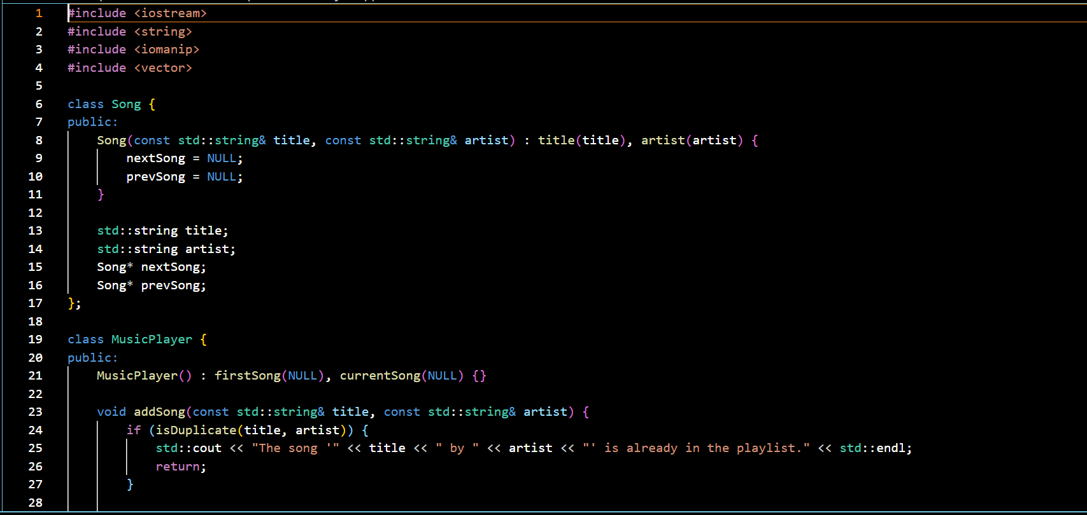
Code:
`

Slide 4
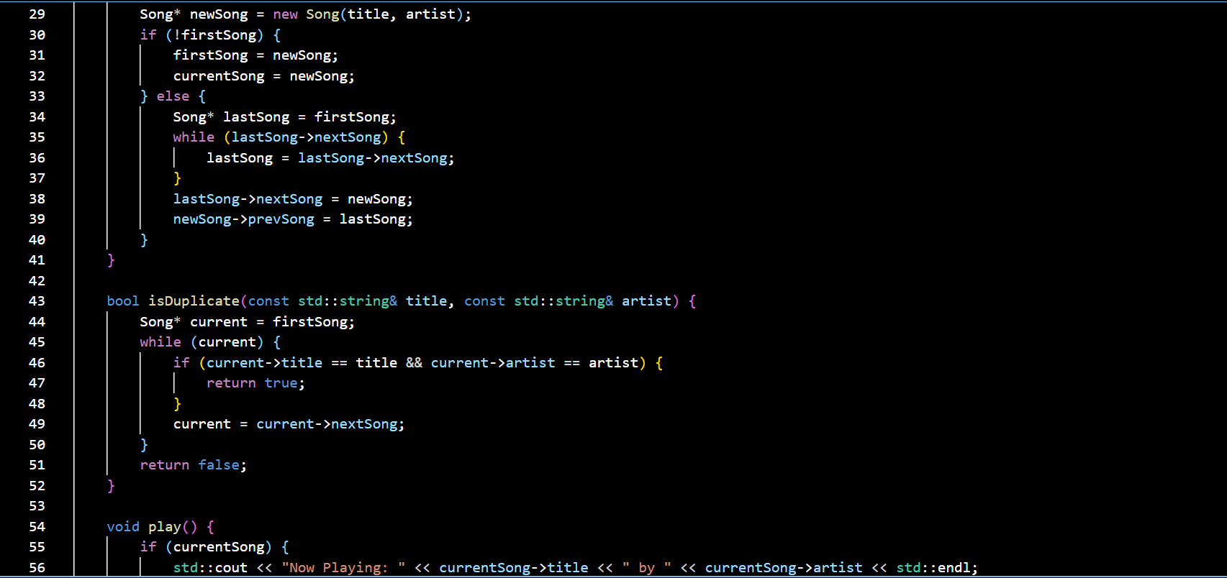

Slide 5
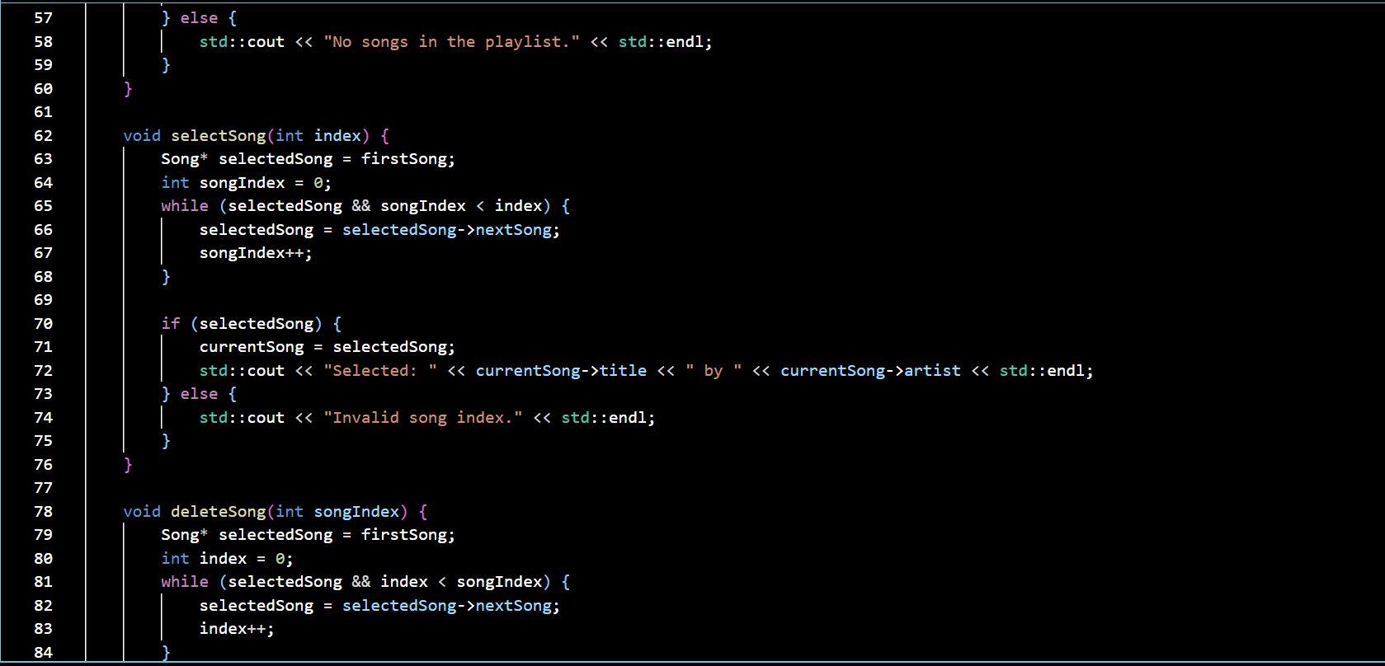

Slide 6
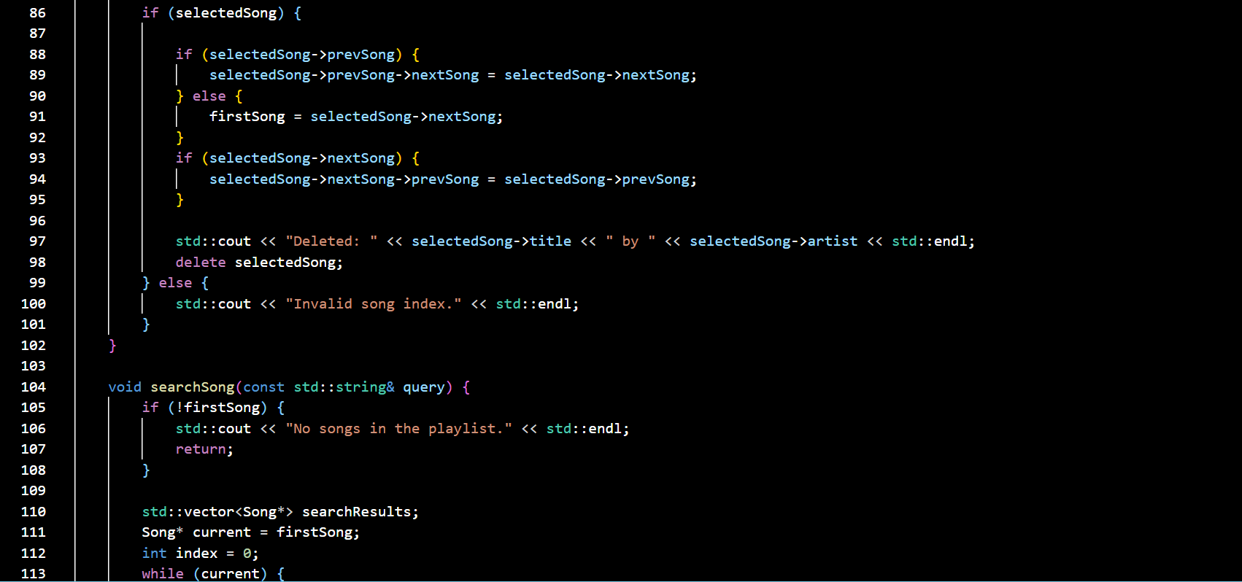

Slide 7
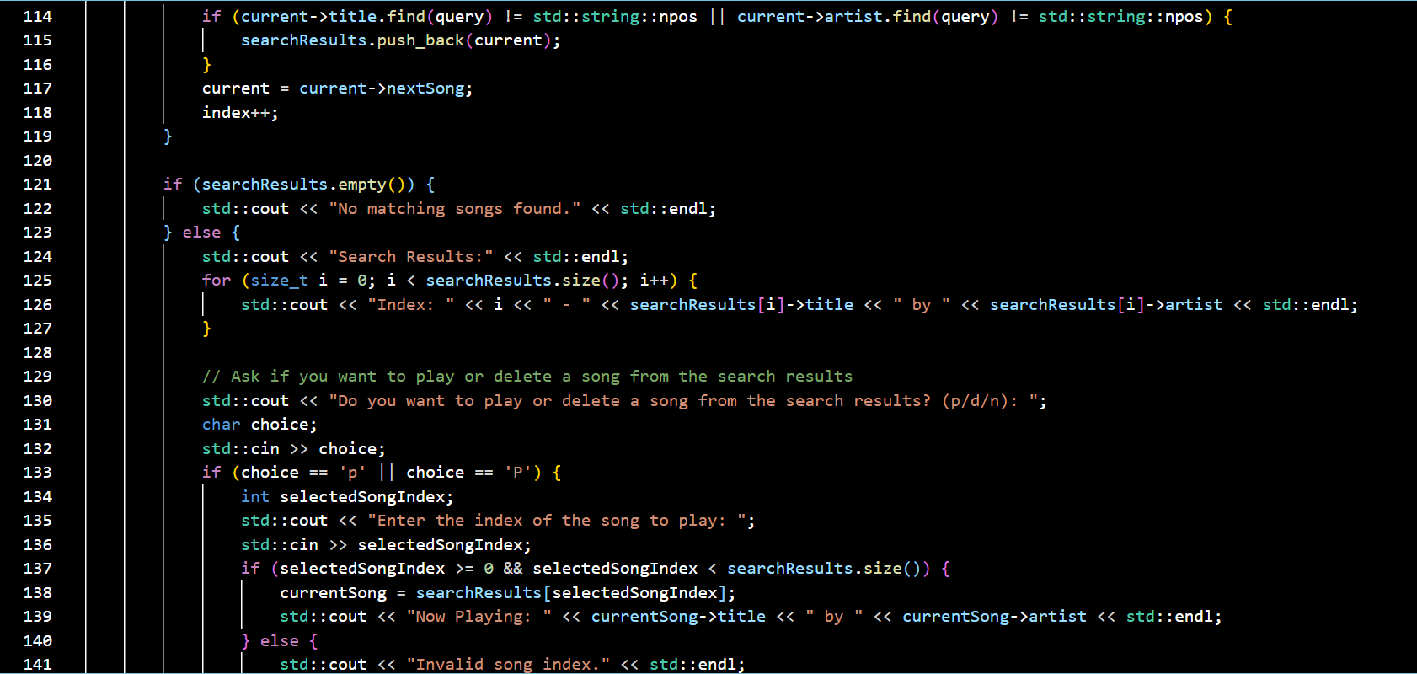

Slide 8
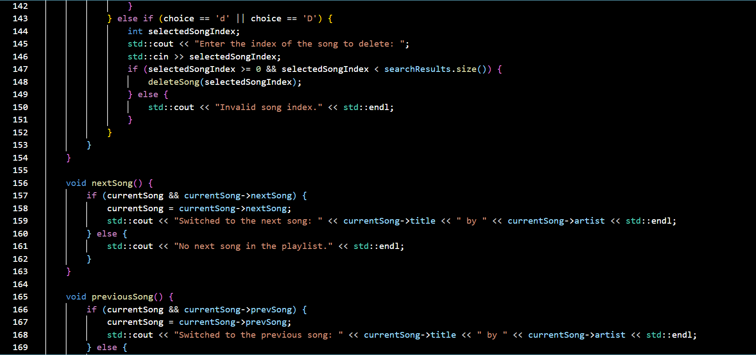

Slide 9
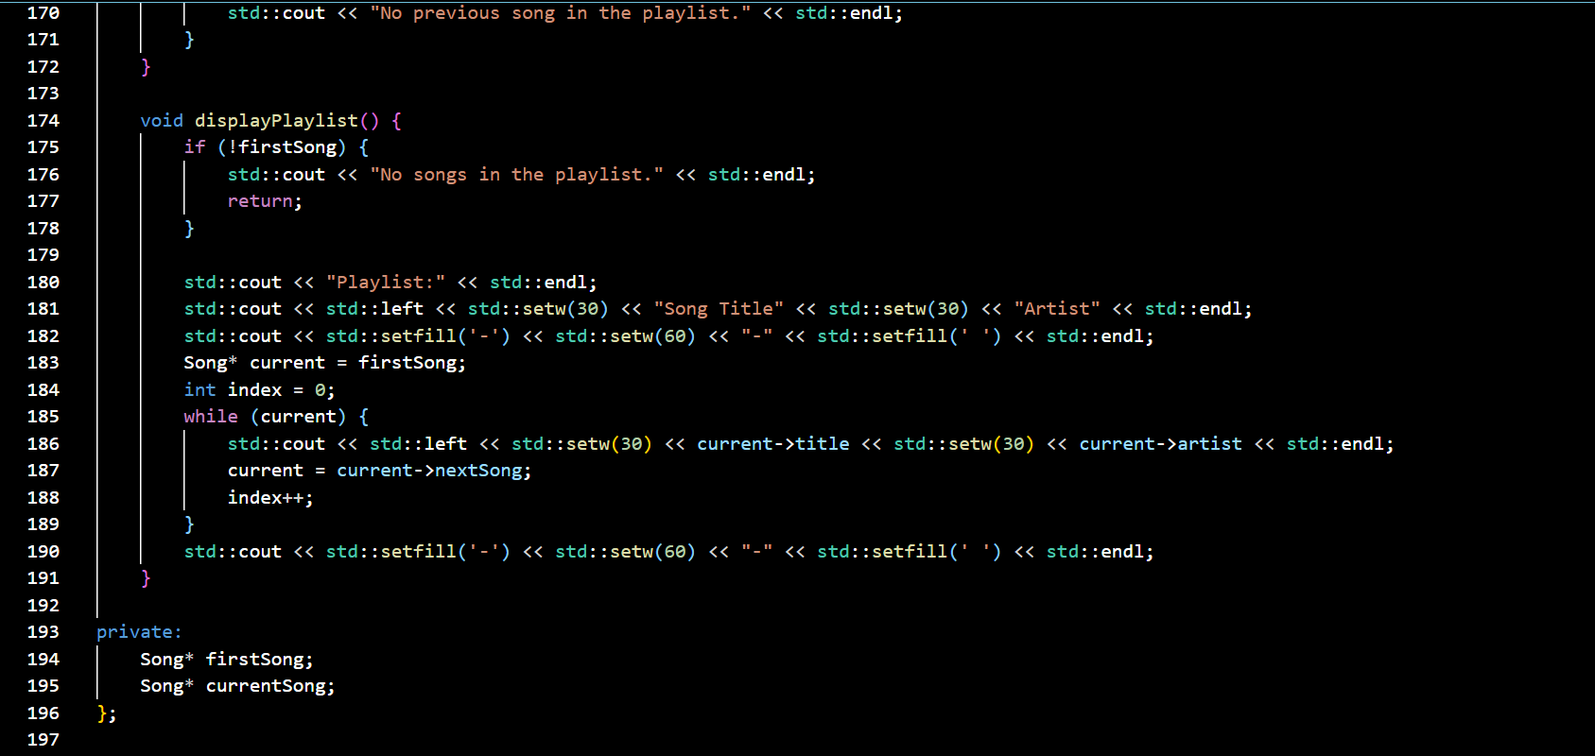

Slide 10
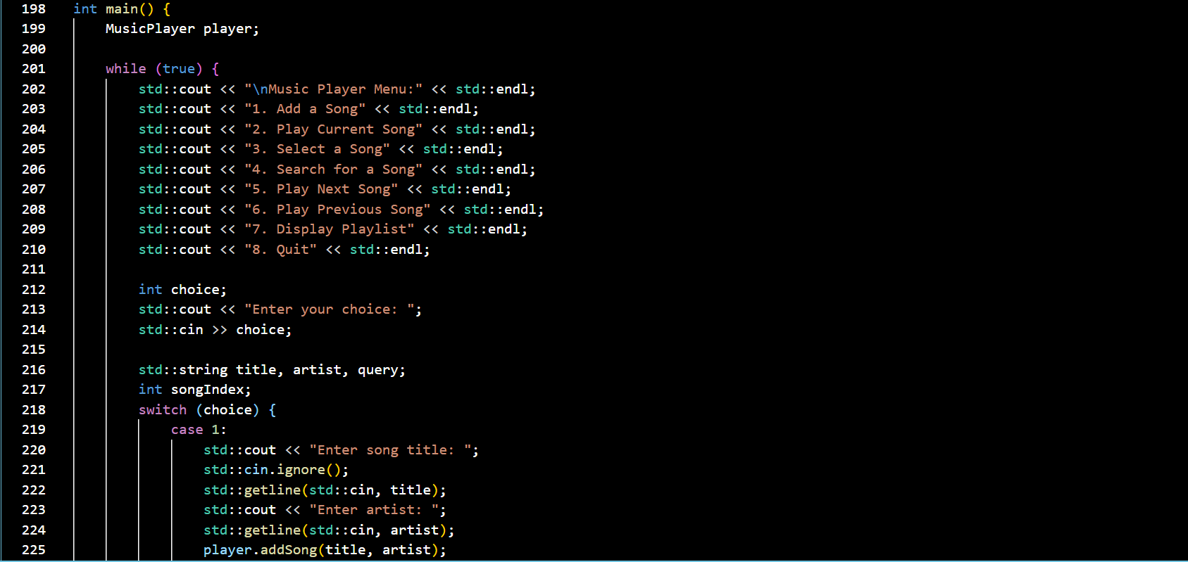

Slide 11
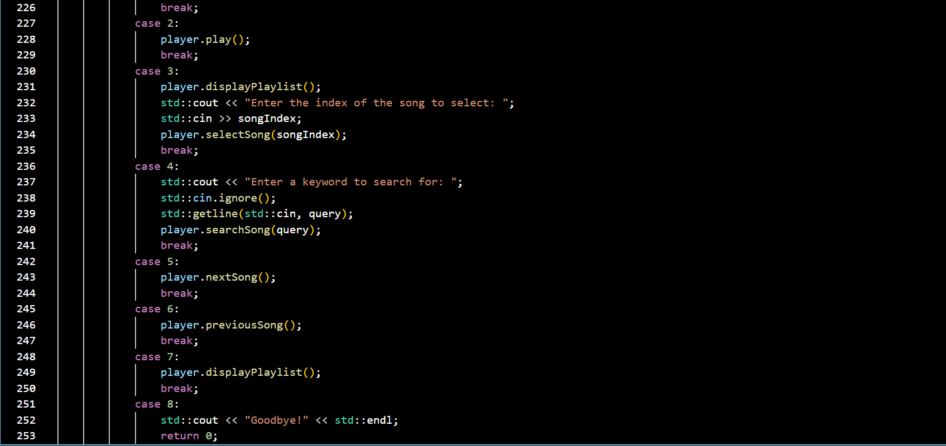

Slide 12
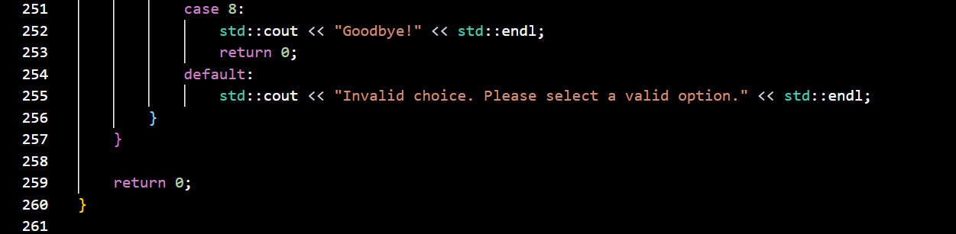

Slide 13
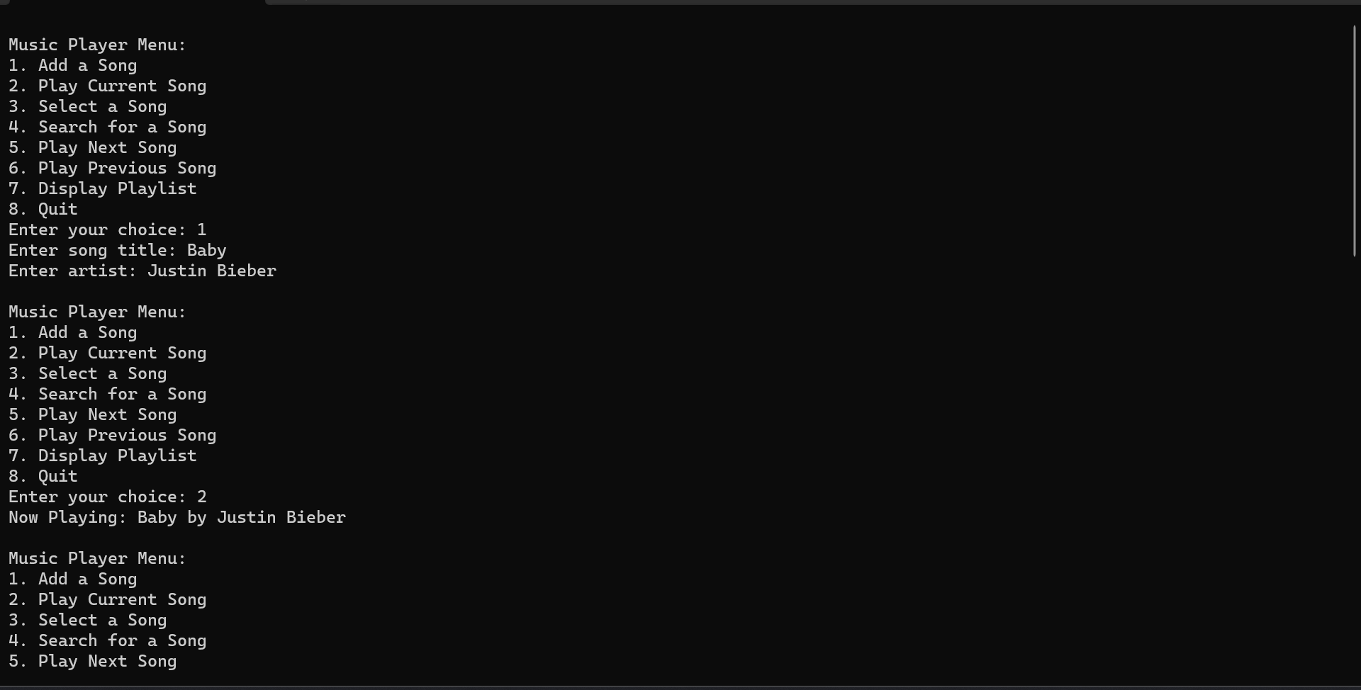
OUTPUT

Slide 14
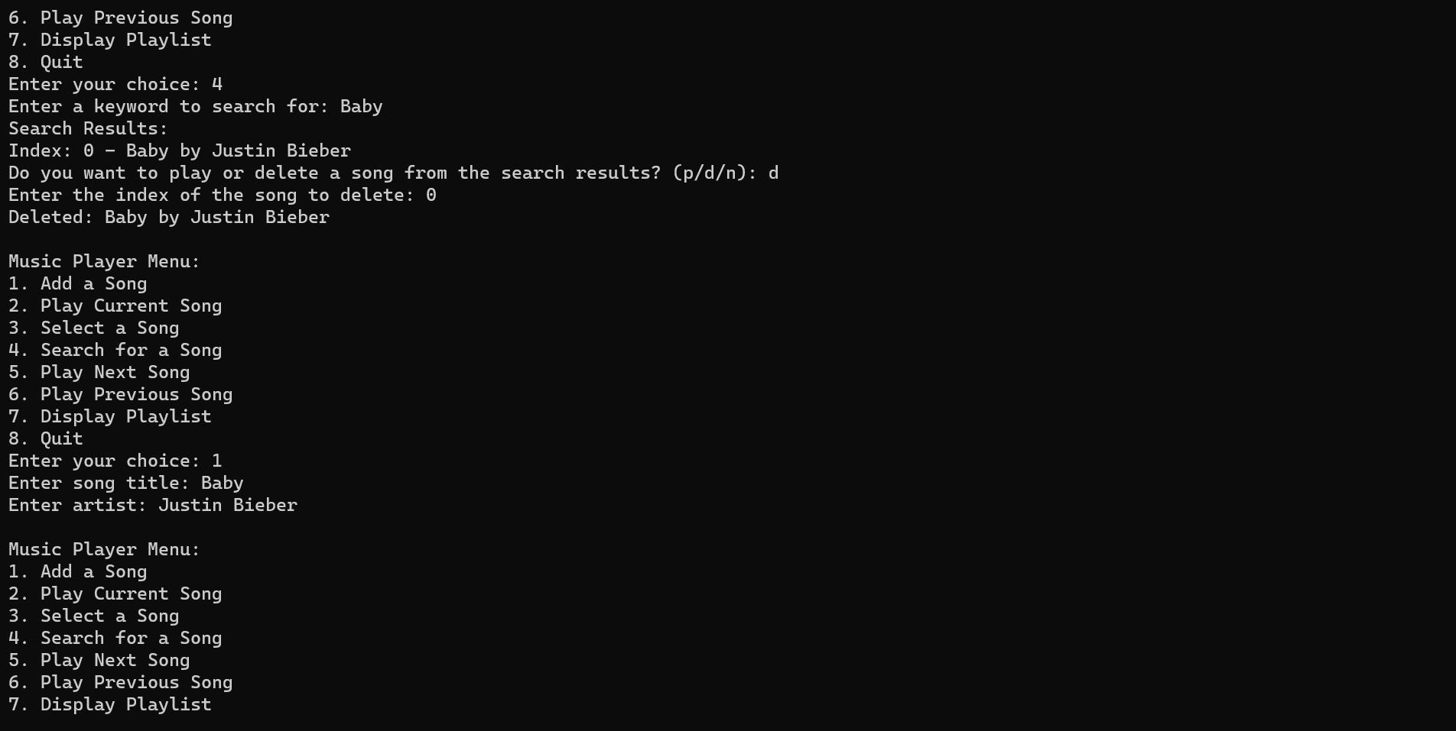

Slide 15
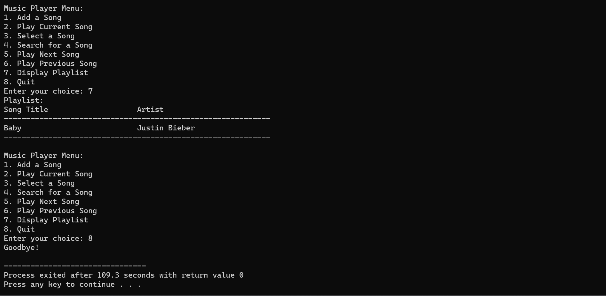

Slide 16
Thank You

